Slide 1

Chapter 3
Introduction to Data Warehousing
Teh Ying Wah
University of Malaya

Slide 2
Learning Outcomes
By the End of this lesson, Learners Will Be Able To:
Define and explain the core concepts of data warehousing and its significance in modern businesses.
Identify the key characteristics of data warehouses and differentiate them from other types of data storage, including data lakes and data lakehouses.
Understand how data warehouses support decision-making and enhance business intelligence, including the integration of AI and machine learning for advanced analytics.
Recognize common challenges in data warehousing projects and strategies to mitigate them.
Differentiate between data warehouses and regular databases in terms of structure, function, and use cases.
Explore emerging future trends in data warehousing, such as quantum computing, edge computing, and multi-cloud strategies.

Slide 3

Course Outline
Introduction to Data Warehousing
Definition and Characteristics of Data Warehousing
Importance of Data Warehousing
Challenges in Data Warehousing
Role of Data Warehousing in Business Intelligence
Comparison: Data Warehouse vs. Database
Data Lakes and Data Lakehouses
Future Trends in Data Warehousing

Slide 4
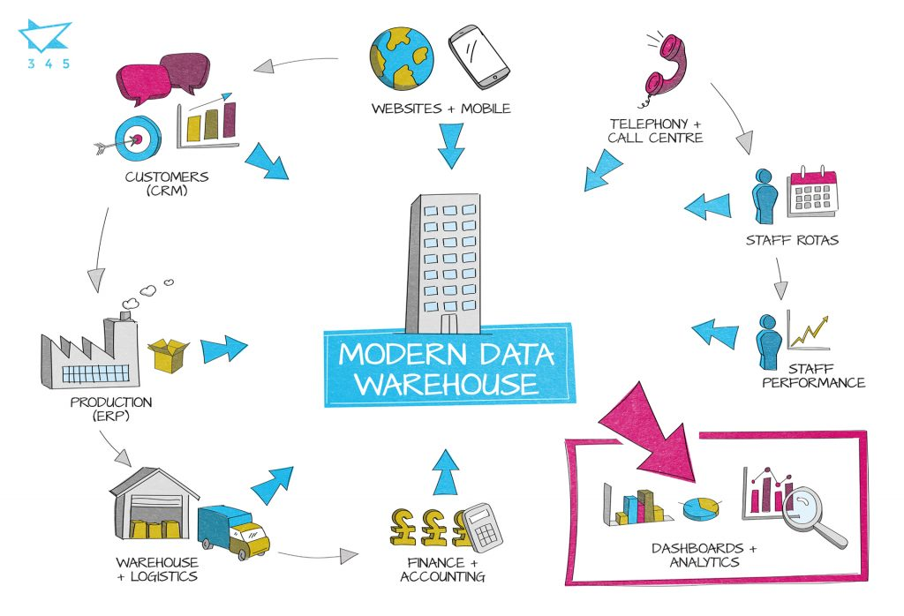
Modern Data Warehousing & Emerging Technologies
Cloud-native data warehousing (e.g., Amazon Redshift, Google BigQuery, Snowflake)
AI and Machine Learning integration for enhanced analytics
Real-time analytics and decision-making
[1]

Slide 5
Evolution and History of Data Warehousing
1960s
Beginning of Large-scale Data Processing
In the 1960s, computers began to be used for large-scale data processing. Businesses started to see the potential of using data for decision-making and began collecting and storing data.
1970s
Birth of Relational Databases
Dr. Edgar F. Codd, a researcher at IBM, introduced the concept of the relational database in 1970. This was a significant step forward as it allowed data to be organized in tables, making it easier to manage and query.
1980s
Executive Information Systems (EIS)
As businesses collected more data, there was a need for systems that could help top executives make decisions. This led to the development of Executive Information Systems (EIS) which provided a dashboard view of the business.

Slide 6

Evolution and History of Data Warehousing
Late 1980s
Emergence of Data Warehousing Concept
Barry Devlin and Paul Murphy from IBM wrote a paper in 1988 that introduced the concept of the "business data warehouse", which was essentially the first formal definition of a data warehouse.
1990s
Growth and Maturity
The 1990s saw rapid advancements in data warehousing technologies and tools. Data extraction, transformation, and loading (ETL) processes became more sophisticated. OLAP (Online Analytical Processing) tools were developed, allowing for multi-dimensional analysis of data.
2000s
Real-time and Near-real-time Data Warehousing
As the internet and digital technologies took off, businesses wanted to make decisions in real-time or near-real-time. This led to the development of data warehouses that could update data in real-time.

Slide 7
Evolution and History of Data Warehousing
2010s: Big Data and Advanced Analytics
With the explosion of big data, traditional data warehouses struggled to handle the volume, variety, and velocity of data. This led to the rise of new data processing frameworks like Hadoop. Data warehouses started integrating with big data platforms.
Today: Cloud-based Data Warehousing
Modern data warehouses are often cloud-based, like Amazon Redshift, Google BigQuery, or Snowflake. They offer scalability, flexibility, and are integrated with advanced analytics and machine learning capabilities.

Slide 8

Definition of Data Warehousing
A data warehouse is a central repository of integrated data from disparate sources, designed to support the analysis, reporting, and decision-making processes within an organization.
It consolidates, transforms, and stores historical data from operational systems and external data sources to provide a unified, consistent view of the information.
The data is subject-oriented, time-variant, non-volatile, and integrated.

Slide 9
Importance of Data Warehousing
Real-time and near-real-time decision-making
Scalability and cost-efficiency with cloud-native platforms
Supports advanced analytics (AI/ML)
Multi-cloud and hybrid strategies
Example: A company using AWS for compute-heavy tasks while leveraging Google BigQuery for its advanced analytics capabilities.
Example: A healthcare organization storing patient records on-premise for compliance but using a cloud platform for real-time analytics.

Slide 10
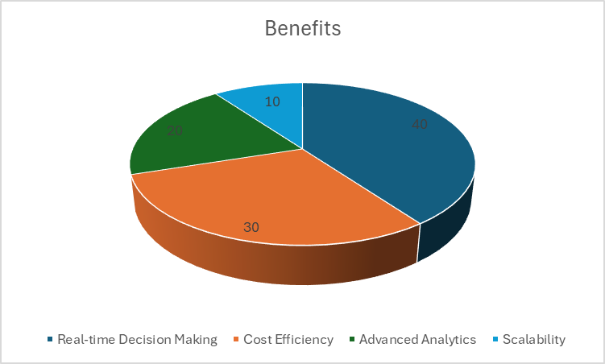
Importance of Data Warehousing

Slide 11

Some common reasons why data warehousing projects may fail:
1. Lack of Clear Objectives and Requirements
2. Poor Planning and Project Management
3. Inadequate Resources
4. Data Quality Issues
5. Complexity and Technical Challenges
6. User Resistance and Lack of Stakeholder Buy-in
7. Insufficient User Training and Support
8. Scope Creep

Slide 12

Role of Data Warehousing in Business Intelligence
Business Intelligence (BI) encompasses the technologies, practices, and tools that enable individuals and organizations to collect, analyse, and present business information to support better decision-making.
The role of Data Warehousing in Business Intelligence is pivotal and multifaceted, serving as the foundation upon which BI systems are built.

Slide 13

Below are several key roles that Data Warehousing plays in Business Intelligence:
1. Centralized Data Repository:
A data warehouse acts as a centralized data repository where data from various sources is integrated, cleaned, transformed, and stored.
This centralization is crucial for providing a unified and consistent view of the data, enabling accurate and reliable reporting and analysis.
2. Historical Data Storage and Analysis:
It stores historical data, allowing organizations to perform trend analyses, comparisons, and forecasting.
This ability to analyse historical data helps in identifying patterns, predicting future trends, and making informed decisions.

Slide 14
Below are several key roles that Data Warehousing plays in Business Intelligence:
3. Enhanced Data Quality and Consistency:
The ETL (Extract, Transform, Load) process in data warehousing ensures data is cleansed, transformed, and integrated, leading to improved data quality and consistency across the organization.
High-quality, consistent data is paramount for reliable BI analytics and reporting.
4. Supports Advanced Analytics:
Data Warehouses are optimized for read-access and complex queries, supporting advanced analytics like data mining, predictive analytics, and machine learning, which help in uncovering insights, patterns, and correlations in the data that are not immediately obvious.

Slide 15
Below are several key roles that Data Warehousing plays in Business Intelligence:
5. Enables Descriptive and Diagnostic Analytics:
With the consolidated data, organizations can perform descriptive analytics to understand what has happened and diagnostic analytics to understand why something has happened, which are the foundational steps in BI.
6. Facilitates Decision-Making Process:
By providing a structured and comprehensive data source, data warehousing empowers BI tools to create reports, dashboards, and visualizations that aid decision-makers in making informed, data-driven decisions swiftly.

Slide 16

Below are several key roles that Data Warehousing plays in Business Intelligence:
7. Improves Operational Efficiency:
The separation of analytical and transactional workloads allows operational systems to perform at optimal efficiency while simultaneously enabling sophisticated analytical activities, without one impacting the other.
8. Ensures Data Security and Compliance:
Data warehouses have robust security features to protect sensitive business data and ensure compliance with various regulations, providing a secure environment for storing and analysing organizational data.

Slide 17

Below are several key roles that Data Warehousing plays in Business Intelligence:
9. Enhances User Accessibility and Productivity:
It structures data in a way that is accessible and understandable to end-users, allowing them to create their reports and analyses, which leads to improved productivity and self-service BI.
In Business Intelligence, a data warehouse is not just a storage facility for data but is a strategic asset that serves as the backbone for intelligent analysis, reporting, and decision-making processes, enabling organizations to navigate the complexities of the modern business environment effectively.

Slide 18
A Data Warehouse vs a Database
The terms “Data Warehousing” and “Databases” are often used interchangeably but refer to different concepts in the realm of data management. Below are the key distinctions between a Data Warehouse and a Database.
1. Purpose:
Database:
Designed to store and manage transactional data and enable CRUD (Create, Read, Update, Delete) operations for applications and services.
Data Warehouse:
Designed for analytical processing, enabling complex queries, reporting, and analysis of large volumes of integrated data.

Slide 19

A Data Warehouse vs a Database
2. Data Type and Structure:
Database:
Typically stores current, operational, and transactional data with a focus on data accuracy and integrity.
Uses a normalized structure to eliminate redundancy and maintain data integrity.
Data Warehouse:
Stores historical, aggregated, and summarized data from various sources.
Uses a denormalized structure (such as Star Schema or Snowflake Schema) optimized for read access and analytical processing.

Slide 20

A Data Warehouse vs a Database
3. Volume and Scale:
Database:
Ideal for managing smaller volumes of transactional data with high transaction rates.
Data Warehouse:
Designed to handle very large volumes of data and is highly scalable to accommodate growing data needs.

Slide 21
A Data Warehouse vs a Database
4. Performance:
Database:
Optimized for high-concurrency, transactional processing with emphasis on ACID properties.
Data Warehouse:
Optimized for query performance and is designed to efficiently run complex queries and analyses on large datasets
5. Data Integration:
Database:
Typically focused on storing data from a single application or system and does not inherently support data integration from multiple sources.
Data Warehouse:
Integrates data from multiple heterogeneous sources, providing a consolidated view of organizational data.

Slide 22
A Data Warehouse vs a Database
6. Usage:
Database:
Suited for day-to-day operations such as order processing, inventory management, and customer relationship management.
Data Warehouse:
Suited for strategic activities like business analysis, decision support, and knowledge discovery.
7. Time Variant:
Database:
Usually contains current or near-real-time data with limited historical data.
Data Warehouse:
Maintains extensive historical data to support trend analysis, forecasting, and comparisons over time.

Slide 23

A Data Warehouse vs a Database
8. Data Processing:
Database:
Emphasizes OLTP (Online Transaction Processing) which involves managing transaction-oriented applications.
Data Warehouse:
Emphasizes OLAP (Online Analytical Processing) which involves the analysis of data to support decision-making processes.
9. Data Modification:
Database:
Frequent updates, deletions, and insertions occur due to the transactional nature of applications.
Data Warehouse:
Mostly read-oriented with periodic updates, usually through ETL processes, and is essentially static between updates.

Slide 24

Summary
While both databases and data warehouses are essential components of an organization's data management strategy, they serve different purposes and have different characteristics.
A database is more suited for managing transactional data and ensuring data integrity,
while a data warehouse is designed to support the analytical needs of the organization by providing integrated, historical, and summarized data.

Slide 25

Data Lakes and Lakehouses
Data Lakes: Manage unstructured data (e.g., Hadoop, Azure Data Lake)
Data Lakehouse: Combines warehouse and lake benefits (Databricks, Delta Lake)
Supports both structured and unstructured data analytics

Slide 26
Future Trends in Data Warehousing
Quantum computing and edge computing
Quantum computing represents the next frontier in computational power, with potential applications in data warehousing and analytics.
Edge computing allows data processing to occur closer to the data source, reducing latency and bandwidth use.
Blockchain for secure data warehousing
Self-healing data warehouses driven by AI

Slide 27

Reference
[1] https://345.technology/what-can-a-modern-data-warehouse-do-for-you/

